Slide 1
Binary search trees
David Kauchak CS 140 – Spring 2024

Slide 2
Admin
Assignment 3 out
Partner assignment
Can work with anyone
Coding + paper (two separate submissions)

Slide 3
Stock market problem

Slide 4
Binary Search Trees

Slide 5
Binary Search Trees
BST – A binary tree where a parent’s value is greater than all values in the left subtree and less than or equal to all the values in the right subtree
And the left and right children are also binary search trees
Why not?
Ambiguous about where elements that are equal would reside

Slide 6
Example
12
8
14
5
9
20
Can be implemented with with references or an array

Slide 7
What else can we conclude?
12
The smallest element is the left-most element
The largest element is the right-most element
8
14
5
9
20

Slide 8
Another example: the solo tree
12

Slide 9
Another example: the twig
12
8
5
1

Slide 10
Operations
Search(T, k) – Does value k exist in tree T
Insert(T, k) – Insert value k into tree T
Delete(T, x) – Delete node x from tree T
Minimum(T) – What is the smallest value in the tree?
Maximum(T) – What is the largest value in the tree?
Successor(T, x) – What is the next element in sorted order after x
Predecessor(T, x) – What is the previous element in sorted order of x
Median(T) – return the median of the values in tree T

Slide 11
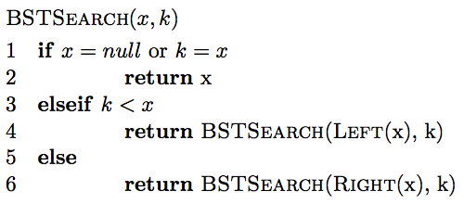
Search
How do we find an element?

Slide 12
Finding an element
Search(T, 9)
12
8
14
5
9
20

Slide 13
Finding an element
Search(T, 9)
12
8
14
5
9
20

Slide 14
Finding an element
Search(T, 9)
12
8
14
5
9
20
9 > 12?

Slide 15
Finding an element
Search(T, 9)
12
8
14
5
9
20

Slide 16
Finding an element
Search(T, 9)
12
8
14
5
9
20

Slide 17
Finding an element
Search(T, 9)
12
8
14
5
9
20

Slide 18
Finding an element
Search(T, 13)
12
8
14
5
9
20

Slide 19
Finding an element
Search(T, 13)
12
8
14
5
9
20

Slide 20
Finding an element
Search(T, 13)
12
8
14
5
9
?
20

Slide 21
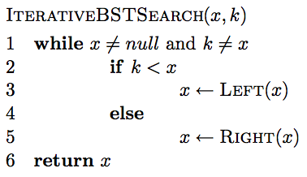
Iterative search

Slide 22
Is BSTSearch correct?

Slide 23
Running time of BSTSearch
Worst case?
θ(height of the tree)
Average case?
O(height of the tree)
Best case?
O(1)

Slide 24
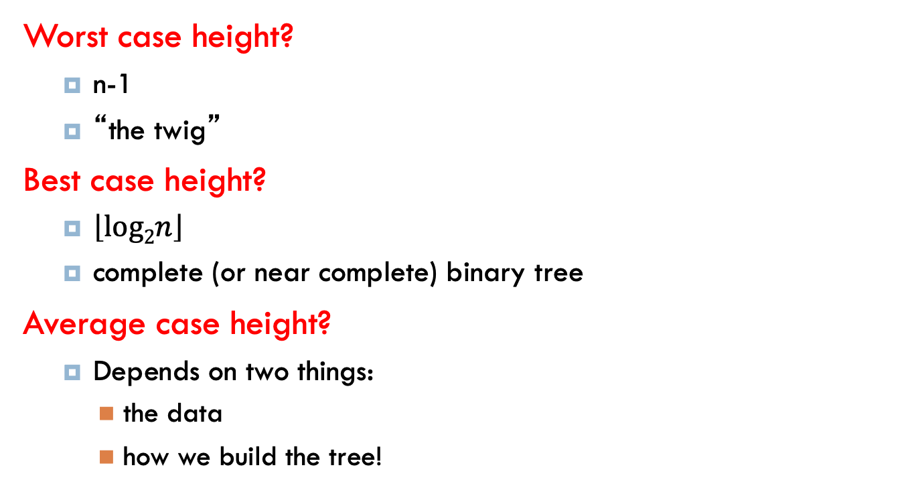
Height of the tree
Worst case height?
n-1
“the twig”
Best case height?
$\left\lfloor log2n\right\rfloor$
complete (or near complete) binary tree
Average case height?
Depends on two things:
the data
how we build the tree!

Slide 25
Insertion
Search and then insert when you find a “null” spot in the tree.

Slide 26
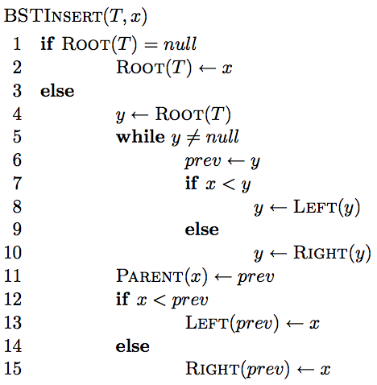
Insertion

Slide 27
Insertion
Similar to search

Slide 28
Insertion
Similar to search
Find the correct location in the tree

Slide 29
Insertion
keeps track of the previous node we visited so when we fall off the tree, we know

Slide 30
Insertion
add node onto the bottom of the tree

Slide 31
Correctness?
maintain BST property

Slide 32
Correctness
What happens if it is a duplicate?

Slide 33
Inserting duplicates
Insert(T, 14)
12
8
14
5
9
20

Slide 34
Inserting duplicates
Insert(T, 14)
12
8
14
5
9
20
14

Slide 35
Running time
Search and then insert when you find a “null” spot in the tree
O(height of the tree)

Slide 36
Running time
Search and then insert when you find a “null” spot in the tree
O(height of the tree)
When we use Big Theta, we are asserting that the function has both an upper and a lower bound at the given rate.
In the case of BST operations, we use O(height of the tree) instead of Θ(height of the tree) because:
- The worst case is indeed O(height of the tree), which occurs when the BST is unbalanced and resembles a linked list (in which case the height is n).
- The best case (the tree is perfectly balanced) is Θ(log n), and the height is log n.
Since Θ implies a tight bound (both upper and lower bounds are the same), it's not used for general BSTs because we cannot guarantee the lower bound to be logarithmic; it could be linear in the worst case.
Why not Θ(height of the tree)?

Slide 37
Running time
Insert(T, 15)
12
8
5
1

Slide 38
Height of the tree
Worst case: “the twig” – When will this happen?
Search and then insert when you find a “null” spot in the tree
Notes:
sorted or inversely sorted data (and there are other cases as well)

Slide 39
Height of the tree
Best case: “complete” – When will this happen?
Search and then insert when you find a “null” spot in the tree

Slide 40
Height of the tree
Average case for random data?
Search and then insert when you find a “null” spot in the tree
Randomly inserting data into a BST generates a tree on average that is O(log n).

Slide 41
Visiting all nodes
In sorted order
12
8
14
5
9
20

Slide 42
Visiting all nodes
In sorted order
5
12
8
14
5
9
20

Slide 43
Visiting all nodes
In sorted order
5, 8
12
8
14
5
9
20

Slide 44
Visiting all nodes
In sorted order
5, 8, 9
12
8
14
5
9
20

Slide 45
Visiting all nodes
In sorted order
5, 8, 9, 12
12
8
14
5
9
20

Slide 46
Visiting all nodes
What’s happening?
5, 8, 9, 12
12
8
14
5
9
20

Slide 47
Visiting all nodes
In sorted order
5, 8, 9, 12, 14
12
8
14
5
9
20

Slide 48
Visiting all nodes
In sorted order
5, 8, 9, 12, 14, 20
12
8
14
5
9
20

Slide 49
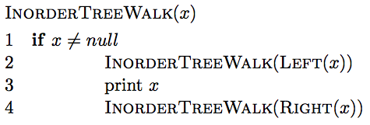
Visiting all nodes in order

Slide 50
Visiting all nodes in order
any operation

Slide 51
Is it correct?
Does it print out all of the nodes in sorted order?

Slide 52
Running time?
Recurrence relation:
j nodes in the left subtree
n – j – 1 in the right subtree
Or
How much work is done for each call?
How many calls?
Θ(n)

Slide 53
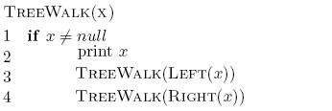
What about?

Slide 54
Preorder traversal
12, 8, 5, 9, 14, 20
Tree copying: insert in to new tree in preorder
prefix notation: (2+3)*4 -> * + 2 3 4
How is this useful?
12
8
14
5
9
20

Slide 55
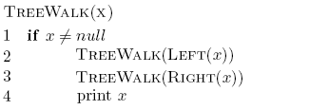
What about?

Slide 56
Postorder traversal
5, 9, 8, 20, 14, 12
postfix notation: (2+3)*4 -> 4 3 2 + *
?
How is this useful?
12
8
14
5
9
20

Slide 57
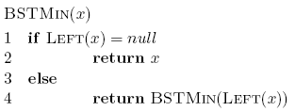

Min/Max
12
8
14
5
9
20

Slide 58
Running time of min/max?
O(height of the tree)

Slide 59
Successor and predecessor
Predecessor(12)?
9
12
8
14
5
9
13
20

Slide 60
Successor and predecessor
Predecessor in general?
The predecessor is the largest node of all those smaller than this node.
12
It is the rightmost element of the left subtree which means “go left once, then go right until you hit the right-most leaf.”
8
14
5
9
13
20

Slide 61
Successor
13
Successor(12)?
12
8
14
5
9
13
20

Slide 62
Successor
Successor in general?
It is smallest node of all those larger than this node.
Leftmost element of the right subtree.
12
8
14
5
9
13
20

Slide 63
Successor
What if the node doesn’t have a right subtree?
smallest node of all those larger than this node
leftmost element of the right subtree
12
8
14
5
9
13
20

Slide 64
Successor
What if the node doesn’t have a right subtree?
The node is the largest
The successor is the node that has x as a predecessor
12
8
14
5
9
13
20

Slide 65
Successor
The successor is the node that has x as a predecessor
12
8
14
5
9
13
20

Slide 66
Successor
successor is the node that has x as a predecessor
12
8
14
5
9
13
20

Slide 67
Successor
successor is the node that has x as a predecessor
12
8
14
5
9
13
20

Slide 68
Successor
We keep going up until we (x) are no longer a right child.
successor is the node that has x as a predecessor
12
8
14
5
9
13
20

Slide 69
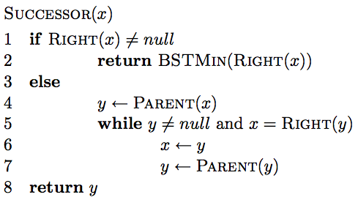
Successor

Slide 70
Successor
If we have a right subtree, return the smallest of the right subtree

Slide 71
Successor
Find the node that x is the predecessor of
Keep going up until we’re no longer a right child.

Slide 72
Successor running time
O(height of the tree)

Slide 73
Deletion
12
8
14
5
9
13
20
Three cases!

Slide 74
Deletion: case 1
No children
Just delete the node
12
8
14
5
9
13
20
17

Slide 75
Deletion: case 1
No children
Just delete the node
12
8
14
5
13
20
17

Slide 76
Deletion: case 2
One child
Splice out the node
12
8
14
5
13
20
17

Slide 77
Deletion: case 2
One child
Splice out the node
12
5
14
13
20
17

Slide 78
Deletion: case 3
Two children
Replace x with its successor
12
5
14
13
20
17

Slide 79
Deletion: case 3
Two children
Replace x with its successor
12
5
17
13
20

Slide 80
Deletion: case 3
Two children.
Will we always have a successor?
Why successor?
Larger than the left subtree
Less than or equal to right subtree.

Slide 81
Height of the tree
Most of the operations take time O(height of the tree)
We said trees built from random data have height O(log n), which is asymptotically tight.
Two problems:
We can’t always insure random data
What happens when we delete nodes and insert others after building a tree?

Slide 82
Balanced trees
Make sure that the trees remain balanced!
Red-black trees
AVL trees
2-3-4 trees
…
B-trees

Slide 83
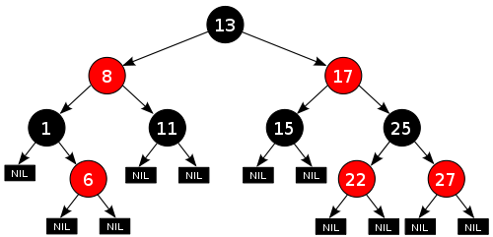
Red-black trees: BST (plus some)
every node is either red or black
root is black
leaves (NIL) are black
if a node is red, both children are black
for every node, all paths from the node to descendant leaves contain the same number of black nodes.
https://en.wikipedia.org/wiki/Red–black_tree

Slide 84
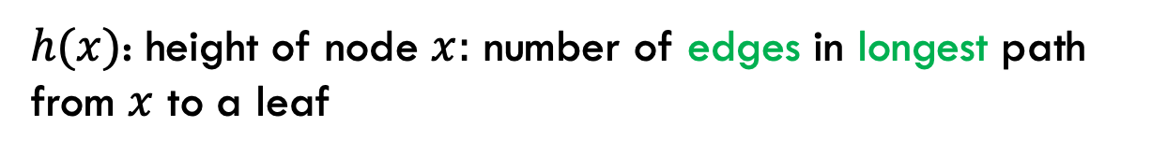
Red-black trees: BST (plus some)
every node is either red or black
root is black
leaves (NIL) are black
if a node is red, both children are black
for every node, all paths from the node to descendant leaves contain the same number of black nodes.
$h(x)$: height of node $x:$ number of edges in longest path from $x$ to a leaf

Slide 85

Red-black trees: BST (plus some)
$h(x)$: height of node $x:$ number of edges in longest path from $x$ to a leaf
What is the height of the root node?

Slide 86
Red-black trees: BST (plus some)
$h(x)$: height of node $x:$ number of edges in longest path from $x$ to a leaf
4

Slide 87
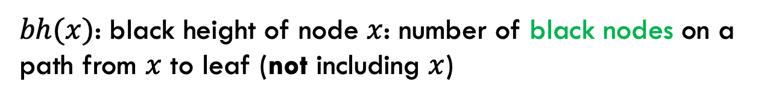
Red-black trees: BST (plus some)
every node is either red or black
root is black
leaves (NIL) are black
if a node is red, both children are black
for every node, all paths from the node to descendant leaves contain the same number of black nodes.
$bh(x)$: black height of node $x$: number of black nodes on a path from $x$ to leaf (not including $x$)
Why don’t we say ”path with the most…”?

Slide 88
Red-black trees: BST (plus some)
every node is either red or black
root is black
leaves (NIL) are black
if a node is red, both children are black
for every node, all paths from the node to descendant leaves contain the same number of black nodes.
$bh(x)$: black height of node $x$: number of black nodes on a path from $x$ to leaf (not including $x$)
Why don’t we say ”path with the most…”?

Slide 89
Red-black trees: BST (plus some)
$bh(x)$: black height of node $x$: number of black nodes on a path from $x$ to leaf (not including $x$)
What is the black height of the root node?

Slide 90
Red-black trees: BST (plus some)
$bh(x)$: black height of node $x$: number of black nodes on a path from $x$ to leaf (not including $x$)
2

Slide 91
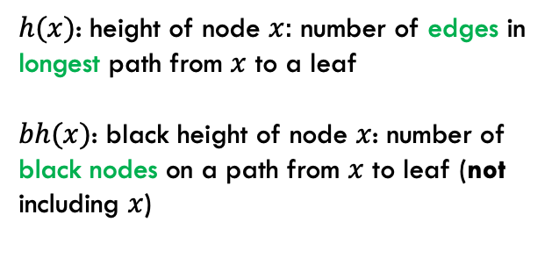
Bounding the height
every node is either red or black
root is black
leaves (NIL) are black
if a node is red, both children are black
for every node, all paths from the node to descendant leaves contain the same number of black nodes.
$h(x)$: height of node $x:$ number of edges in longest path from $x$ to a leaf
$bh(x)$: black height of node $x$: number of black nodes on a path from $x$ to leaf (not including $x$)
Claim 1: For every node $x$, $bh\left(x\right)≥h(x)/2$
Proof?

Slide 92
Bounding the height
every node is either red or black
root is black
leaves (NIL) are black
if a node is red, both children are black
for every node, all paths from the node to descendant leaves contain the same number of black nodes.
$h(x)$: height of node $x:$ number of edges in longest path from $x$ to a leaf
$bh(x)$: black height of node $x$: number of black nodes on a path from $x$ to leaf (not including $x$)
Claim 1: For every node $x$, $bh\left(x\right)≥h(x)/2$
Worst case: nodes alternate red/black
root is black
leaf is black
In terms of h(x): How many black nodes are there on this path?

Slide 93
Bounding the height
every node is either red or black
root is black
leaves (NIL) are black
if a node is red, both children are black
for every node, all paths from the node to descendant leaves contain the same number of black nodes.
$h(x)$: height of node $x:$ number of edges in longest path from $x$ to a leaf
$bh(x)$: black height of node $x$: number of black nodes on a path from $x$ to leaf (not including $x$)
Claim 1: For every node $x$, $bh\left(x\right)≥h(x)/2$
Worst case: nodes alternate red/black
root is black
leaf is black
…

Slide 94

Bounding the height
every node is either red or black
root is black
leaves (NIL) are black
if a node is red, both children are black
for every node, all paths from the node to descendant leaves contain the same number of black nodes.
$h(x)$: height of node $x:$ number of edges in longest path from $x$ to a leaf
$bh(x)$: black height of node $x$: number of black nodes on a path from $x$ to leaf (not including $x$)
Claim 1: For every node $x$, $bh\left(x\right)≥h(x)/2$
Worst case: nodes alternate red/black
root is black
leaf is black
…
$$bh\left(x\right)=h(x)/2$$
(Note that bh does not include the root)

Slide 95

Bounding the height
every node is either red or black
root is black
leaves (NIL) are black
if a node is red, both children are black
for every node, all paths from the node to descendant leaves contain the same number of black nodes.
$h(x)$: height of node $x:$ number of edges in longest path from $x$ to a leaf
$bh(x)$: black height of node $x$: number of black nodes on a path from $x$ to leaf (not including $x$)
Claim 1: For every node $x$, $bh\left(x\right)≥h(x)/2$
Worst case: nodes alternate red/black
root is black
leaf is black
…
$$bh\left(x\right)≥h(x)/2$$
We can remove red nodes, but that would decrease h(x)

Slide 96

Bounding the height
Claim 2: The subtree rooted at any node $x$ contains at least $2^{bh(x)}−1$ internal (non-leaf) nodes
Proof?

Slide 97
Structural induction
Want to prove something about a recursive structure (e.g., a tree)

Slide 98

Structural induction
$$x$$
Proof by induction:
IH: Assume the property holds for sub-structures (i.e., subtrees).
Show that it holds for the entire tree.

Slide 99
Structural induction
$$x$$
Base case is often the smallest structure possible (e.g., a leaf).

Slide 100
Bounding the height
Claim 2: The subtree rooted at any node $x$ contains at least $2^{bh(x)}−1$ internal (non-leaf) nodes
Base case:

Slide 101
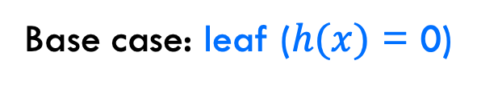
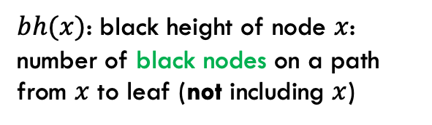


Bounding the height
Claim 2: The subtree rooted at any node $x$ contains at least $2^{bh(x)}−1$ internal (non-leaf) nodes
Base case: leaf ($h(x)$ = 0)
$$bh\left(x\right)= 0$$
$bh(x)$: black height of node $x$: number of black nodes on a path from $x$ to leaf (not including $x$)
$$2^{0}−1=0$$

Slide 102
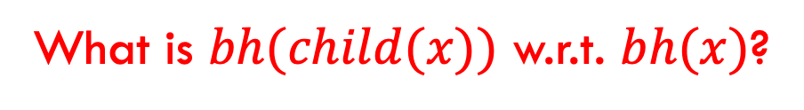
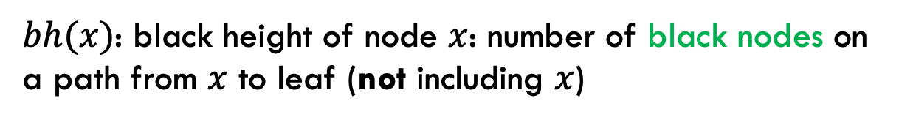

Bounding the height
Claim 2: The subtree rooted at any node $x$ contains at least $2^{bh(x)}−1$ internal (non-leaf) nodes
Inductive case: $h(x)$ > 0
IH: Assume $2^{bh(y)}−1$ for all y that are subtrees of x
What is $bh(child(x))$ w.r.t. $bh(x)$?
$bh(x)$: black height of node $x$: number of black nodes on a path from $x$ to leaf (not including $x$)

Slide 103
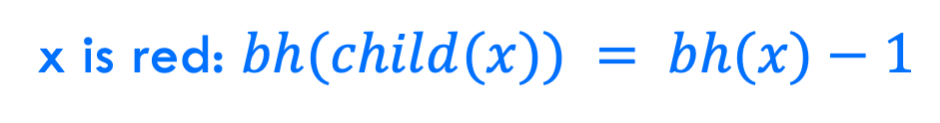

Bounding the height
Claim 2: The subtree rooted at any node $x$ contains at least $2^{bh(x)}−1$ internal (non-leaf) nodes
Inductive case: $h(x)$ > 0
IH: Assume $2^{bh(y)}−1$ for all y that are subtrees of x
x is red: $bh(child(x)) = bh(x)−1$
$bh(x)$: black height of node $x$: number of black nodes on a path from $x$ to leaf (not including $x$)

Slide 104
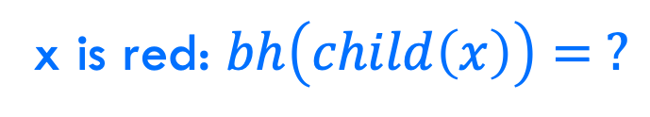


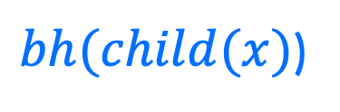
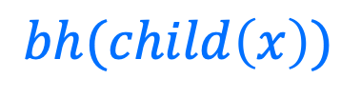
Bounding the height
x is red: $bh\left(child\left(x\right)\right)= ?$
$$x$$
$$bh(child\left(x\right))$$
$bh(child(x)$)
$bh(x)$: black height of node $x$: number of black nodes on a path from $x$ to leaf (not including $x$)

Slide 105
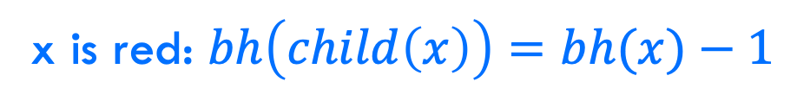
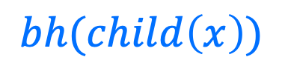
Bounding the height
x is red: $bh\left(child\left(x\right)\right)=bh(x)−1$
$$x$$
$$bh(child\left(x\right))$$
$$bh(child\left(x\right))$$
$bh(x)$: black height of node $x$: number of black nodes on a path from $x$ to leaf (not including $x$)

Slide 106
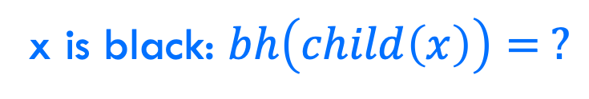
Bounding the height
x is black: $bh\left(child\left(x\right)\right)= ?$
$$x$$
$$bh(child\left(x\right))$$
$$bh(child\left(x\right))$$
$bh(x)$: black height of node $x$: number of black nodes on a path from $x$ to leaf (not including $x$)

Slide 107




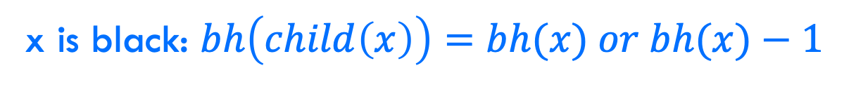

Bounding the height
x is black: $bh\left(child\left(x\right)\right)=bh(x) or bh(x)−1$
$$x$$
$$x$$
$$bh(child\left(x\right))$$
$$bh(child\left(x\right))$$
$$bh(child\left(x\right))$$
$bh(x)$: black height of node $x$: number of black nodes on a path from $x$ to leaf (not including $x$)

Slide 108
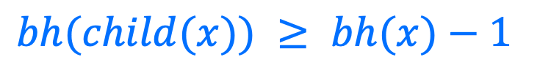
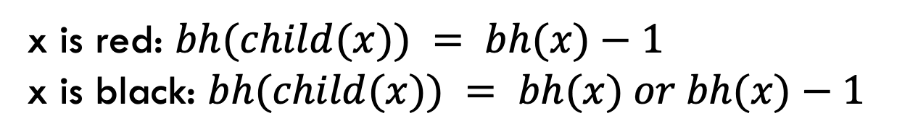
Bounding the height
Claim 2: The subtree rooted at any node $x$ contains at least $2^{bh(x)}−1$ internal (non-leaf) nodes
Inductive case: $h(x)$ > 0
IH: Assume $2^{bh(y)}−1$ for all y that are subtrees of x
x is red: $bh(child(x)) = bh(x)−1$
x is black: $bh(child(x)) = bh(x) or bh(x)−1$
$bh(child(x)) ≥ bh(x)−1$

Slide 109


Bounding the height
Claim 2: The subtree rooted at any node $x$ contains at least $2^{bh(x)}−1$ internal (non-leaf) nodes
Inductive case: $h(x)$ > 0
IH: Assume $2^{bh(y)}−1$ for all y that are subtrees of x
$bh(child(x)) ≥ bh(x)−1$
$$x$$
How many (internal nodes are in this tree (at least)?

Slide 110



Bounding the height
Claim 2: The subtree rooted at any node $x$ contains at least $2^{bh(x)}−1$ internal (non-leaf) nodes
Inductive case: $h(x)$ > 0
IH: Assume $2^{bh(y)}−1$ for all y that are subtrees of x
$bh(child(x)) ≥ bh(x)−1$
$$x$$
$$1$$
$$2^{bh\left(x\right)−1}−1$$
$$2^{bh\left(x\right)−1}−1$$

Slide 111

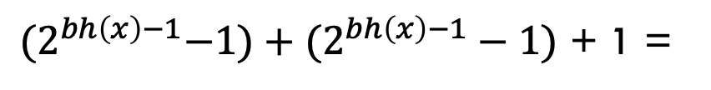
Bounding the height
Claim 2: The subtree rooted at any node $x$ contains at least $2^{bh(x)}−1$ internal (non-leaf) nodes
Inductive case: $h(x)$ > 0
IH: Assume $2^{bh(y)}−1$ for all y that are subtrees of x
$bh(child(x)) ≥ bh(x)−1$
${(2}^{bh\left(x\right)−1}−1)+(2^{bh\left(x\right)−1}−1)$ + 1 =
$$2^{bh\left(x\right)}−1$$

Slide 112
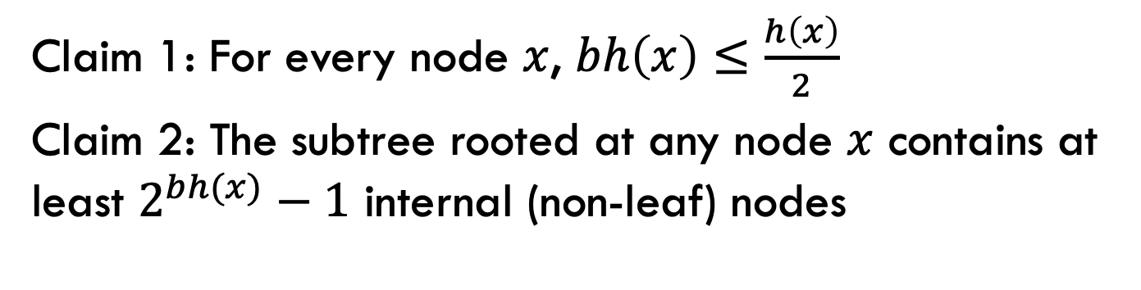
Bounding the height (almost there!)
Claim 1: For every node $x$, $bh\left(x\right)≤\frac{h\left(x\right)}{2}$
Claim 2: The subtree rooted at any node $x$ contains at least $2^{bh(x)}−1$ internal (non-leaf) nodes
How does this help us?

Slide 113

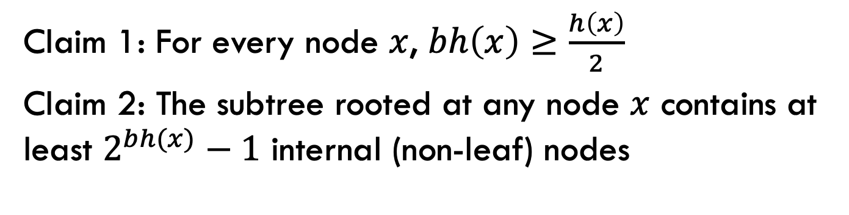



Bounding the height
Claim 1: For every node $x$, $bh\left(x\right)≥\frac{h\left(x\right)}{2}$
Claim 2: The subtree rooted at any node $x$ contains at least $2^{bh(x)}−1$ internal (non-leaf) nodes
${n ≥2}^{bh(x)}−1$
Claim 2
Claim 1
${n ≥2}^{h(x)/2}−1$
math
$${n+1 ≥2}^{h(x)/2}$$
math
$$h\left(x\right) ≤2log⁡(n+1)$$
What does this mean?

Slide 114
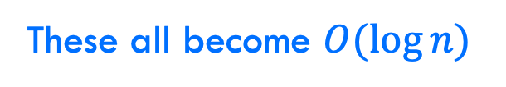
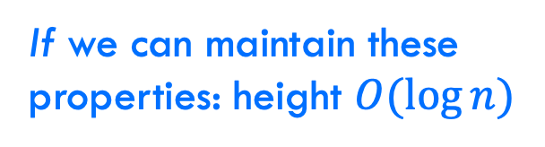
Bounding the height
every node is either red or black
root is black
leaves (NIL) are black
if a node is red, both children are black
for every node, all paths from the node to descendant leaves contain the same number of black nodes.
If we can maintain these properties: height $O(log⁡n)$
Search
Insert
Delete
Maximum
These all become $O(\log{n})$

Slide 115
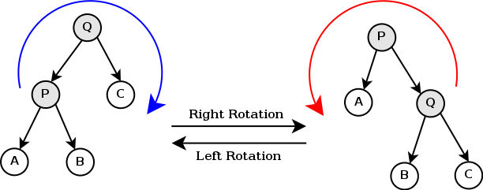
Can it be done?
Can we maintain the red-black tree properties without making insertion and deletion more expensive?
https://en.wikipedia.org/wiki/Tree_rotation#/media/File:Tree_rotation.png

Slide 116
A quick example
https://www.youtube.com/watch?v=vDHFF4wjWYU

Slide 117
Number guessing game
I’m thinking of a number between 1 and n
You are trying to guess the answer
For each guess, I’ll tell you “correct”, “higher” or “lower”
Describe an algorithm that minimizes the number of guesses

